Slide 2
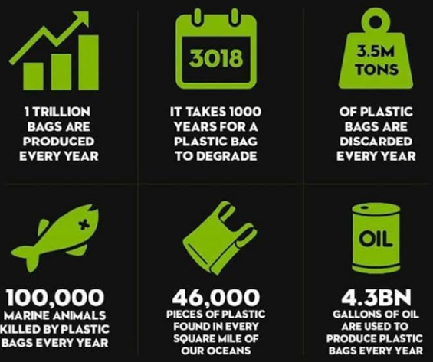
STATISTICAL SITUATION OF THE PROBLEM (SSP)
PER DAY 4600 TONES OF PLASTIC WASTE ARE PRODUCED IN DAR
3600 TONES
UN –ENVIRONMENTAL ROAD MAP REPORT 2018

Slide 3
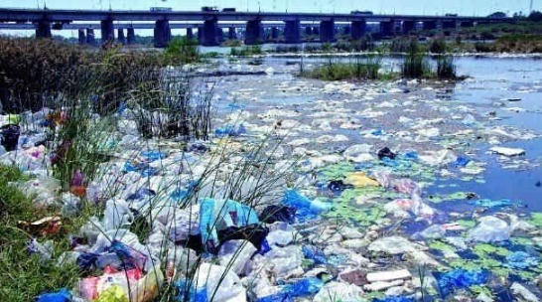
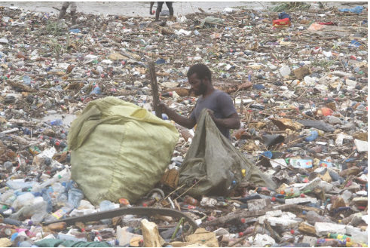
ENVIRONMENTAL PLASTIC POLLUTION
Real situation in Dar es Salaam
Jangwani-Dar

Slide 4
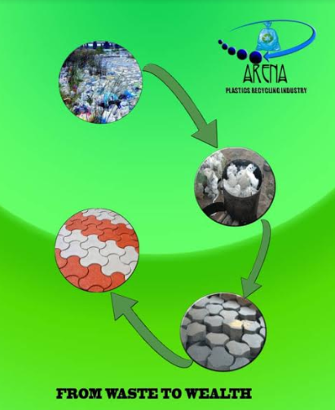
SOLUTION RECYCLING

Slide 5
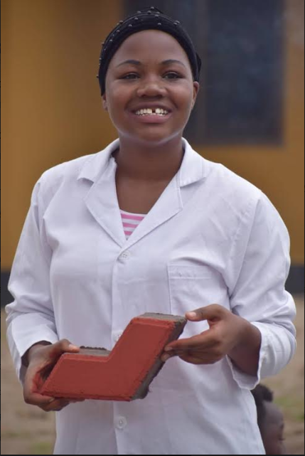
Our Product
Affordable and durable
Water proof,
Ant-Fungal
Sound
Ant - corrosive
Best to construct swimming pool
Market Target-Individuals, Civil& Building Contractors

Slide 6
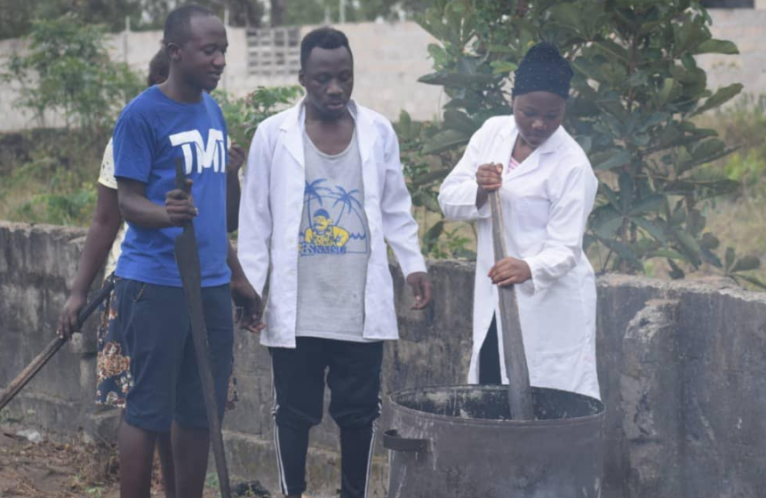
Our Strength
Efficiency in production
Reliable distribution channel
Skilled team
Use of technology
Good Network & link

Slide 7
Competition
Cement Paving Blocks
Existed for long Time
Very Known to users

Slide 8
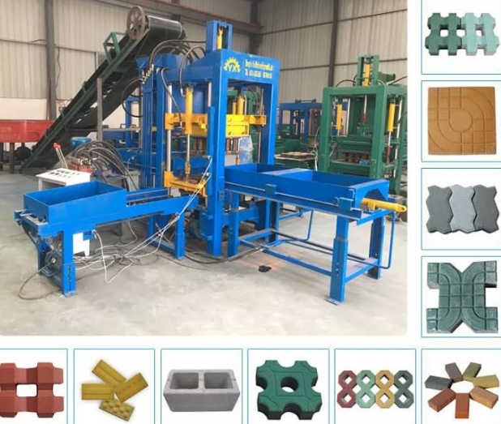
Project Essentials
Site for Production and products display.
Heavy Duty Plastic Melting Machine.
Paving Blocks molding Waste plastic Kerbs
Markerting

Slide 9
Financial Model
NEEDS | COSTS (USD)
Sites for production | 800
Heavy duty advanced machines | 7000
Paving moulds | 1000
5 center kerbs for collection of plastics bags | 1100
Marketing & Exhibition | 600
Total | 10,500

Slide 10
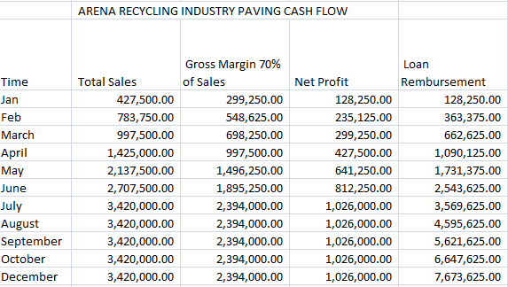

Slide 11
Contacts
DIRECTOR GENERAL
ARENA RECYCLING INDUSTRY
P.O.BOX 6469
DAR ES SALAAM
+255 625 660 795 +255 716 973 403
arena_recycling_industry
+255 625 660 795 +255 716 973 403
hellensailas001@gmail.com

Slide 12
THANKS

